Slide 1

Introduzione al cloud computing

Slide 2
Intro
William Franchini
Solution Architect
Obiettivi
Sapersi orientare
Capire cosa cambia
Polls (vota qui http://etc.ch/qdbA)
Misc

Slide 3
Agenda
Intro
Cloud computing: adozione
Il mercato
Cloud computing: adozione/2
Cloud computing: acceleratori

Slide 4
Cloud Computing
Che vuol dire?
Servizi IT
Applicazioni
Accessibili via internet
Managed
On-Demand

Slide 5
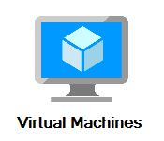

Intro
Risorse
Dimensionamento
Scalabilità
DR
Operazioni
Sicurezza
Compliance

Slide 6
Quick recap
Infrastructure as a Service (IaaS)
Hardware (+OS)
Servizi di storage
Servizi di networking
Platform as a Service (PaaS)
Sviluppo di applicazioni
Servizi e sistemi gestiti dal fornitore
Database, web apps, app firewall, storage NO-SQL, machine learning…
Software as a Service (SaaS)
Asset e Workload

Slide 7
Cloud Computing
Impatti sui sistemi IT
Costi
Scalabilità
Affidabilità
Disponibilità

Slide 8
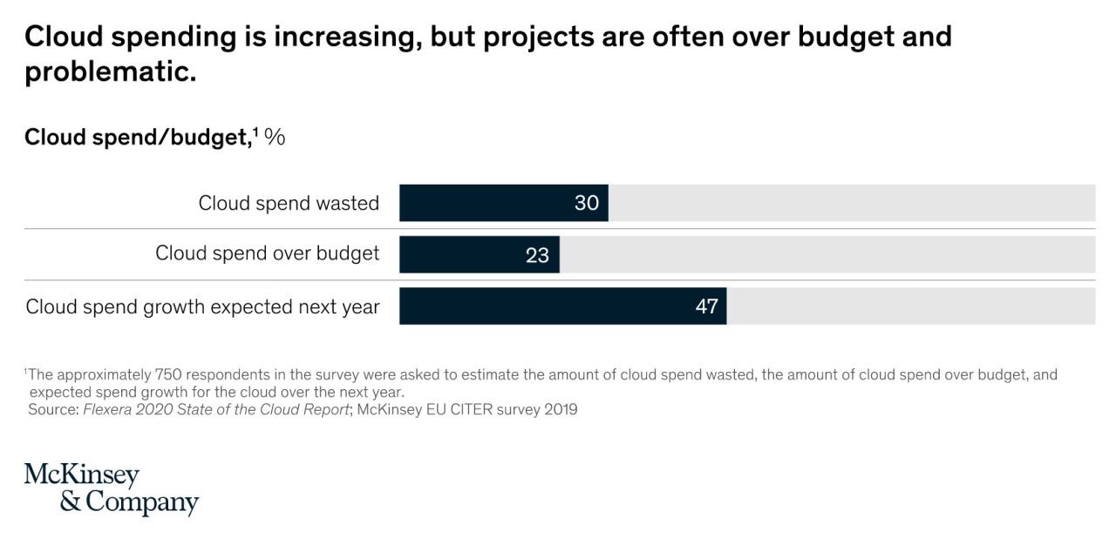

Slide 9
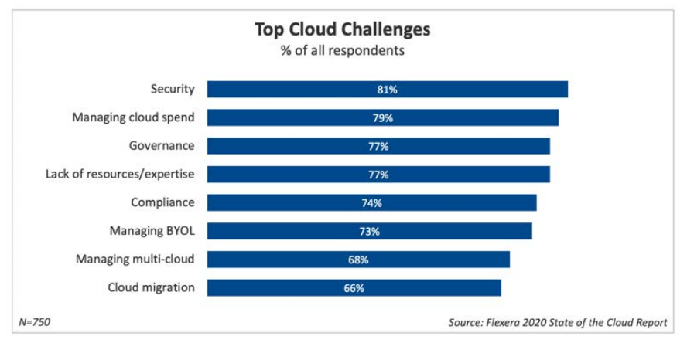

Slide 10
Cloud Computing
Impatti sui sistemi IT
Costi
Scalabilità
Affidabilità
Disponibilità
Tecnologia
Persone/skill
Processi

Slide 11

Cloud computing: adozione

Slide 12
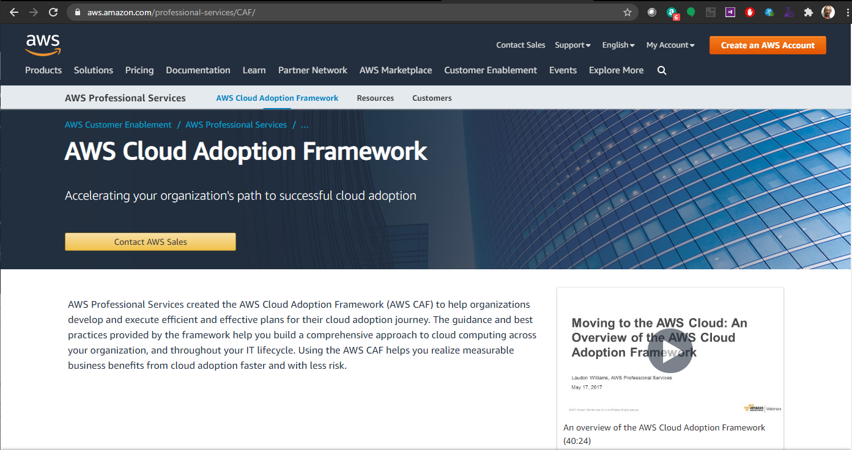

Slide 13
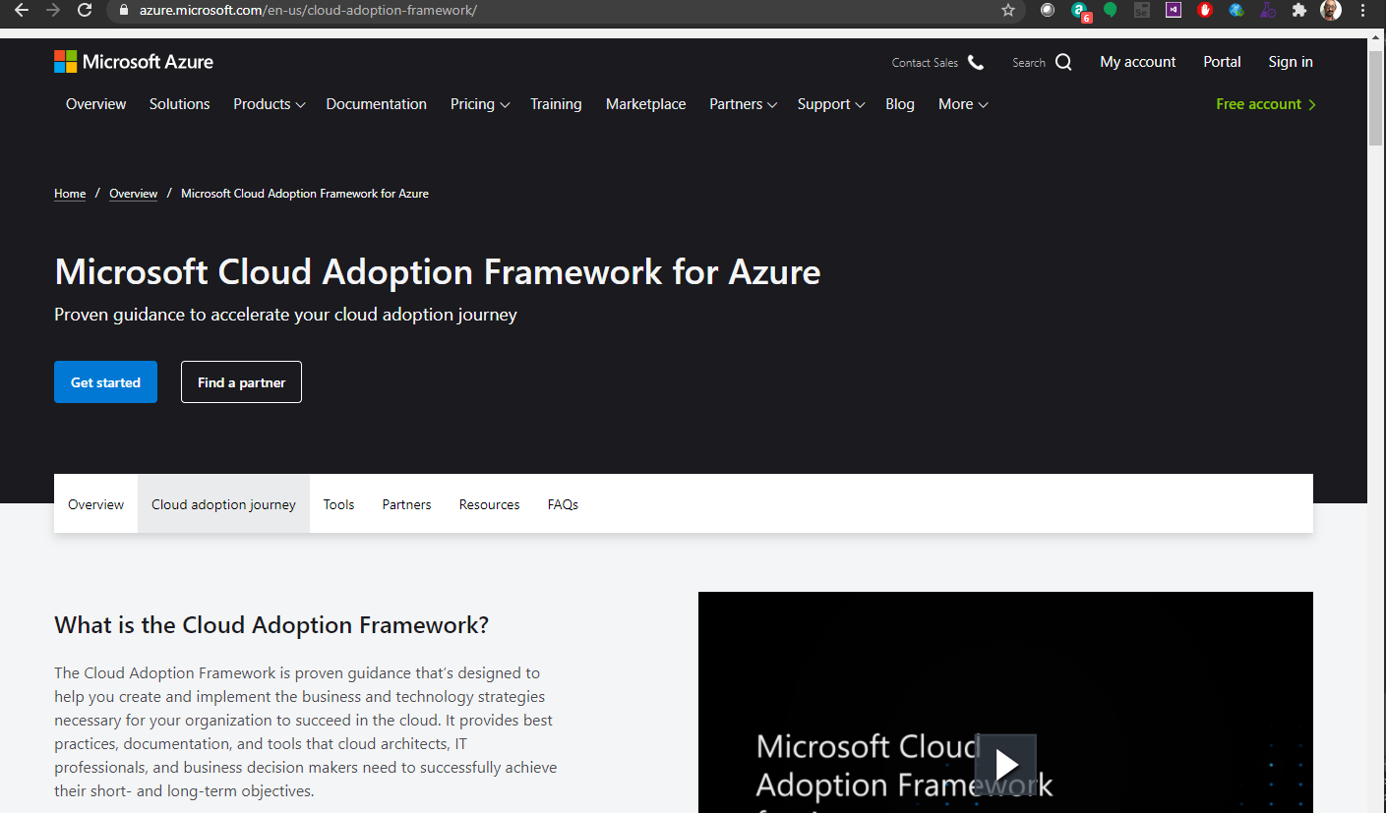

Slide 14
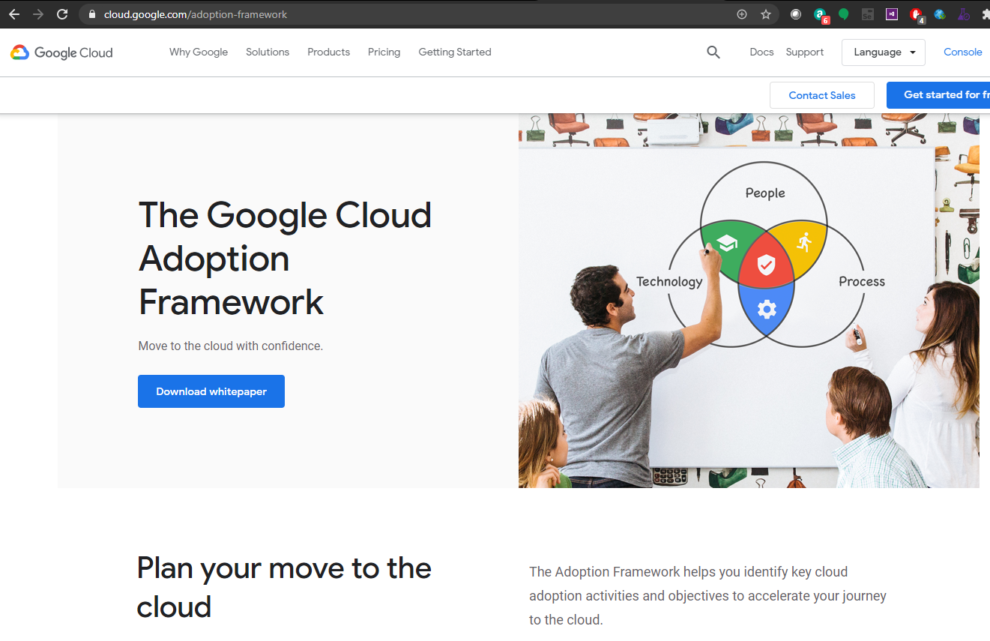

Slide 15
Cloud computing: adozione
Business
Governance
People
Motivation
Change management
Security
Operations
Metrics
Risks
Cost
Cost-effective
Transformation
Strategy
Plan
Cultural issues are at the root of many failed business transformations, yet most organizations do not assign explicit responsibility for culture. – Gartner, 2016

Slide 16
Prospettive
Business
Business Managers; Finance Managers; Budget Owners; Strategy Stakeholders
Governance
CIO; Program Managers; Project Managers; Enterprise Architects; Business Analysts; Portfolio Managers.
People
Human Resources; Staffing; People Managers
Platform
CTO; IT Managers; Solution Architects, Devs
Operations
IT Operations Managers; IT Support Managers.
Security
CISO; IT Security Managers; IT Security Analysts; Head of Audit and Compliance.

Slide 17
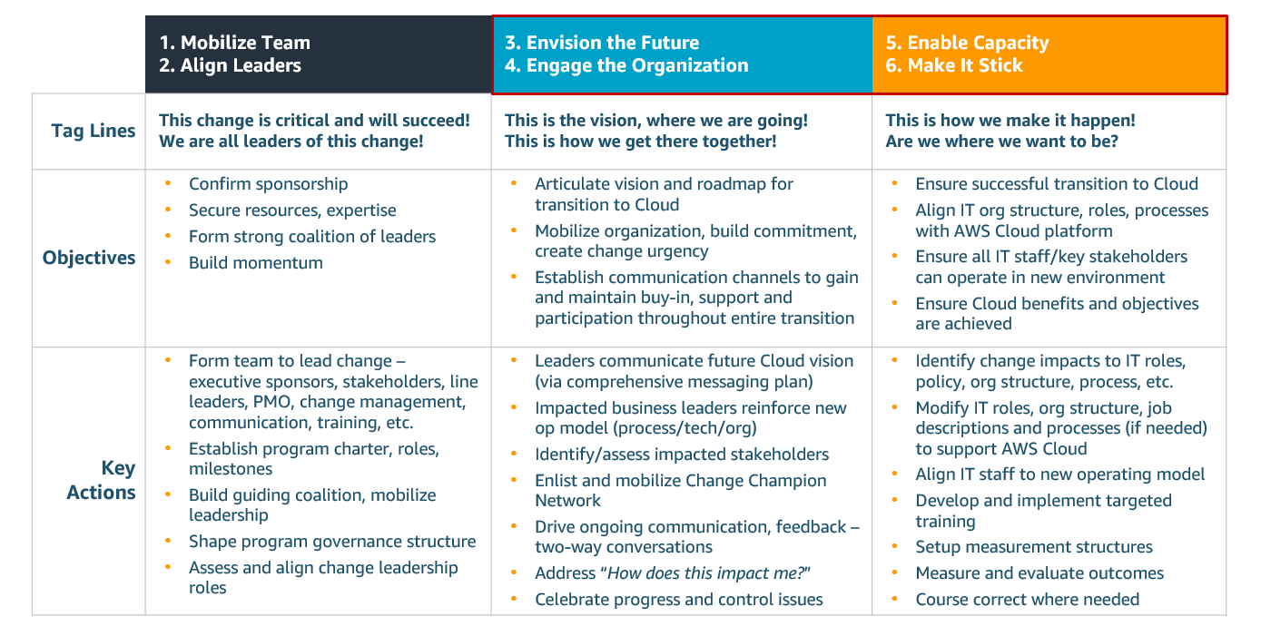
Change management (AWS)
Notes:
Cambiare (processi)

Slide 18
Cloud Center of Excellence (CCoE)
Guida la trasformazione
Best practice
Standard
Evolve nel tempo

Slide 19
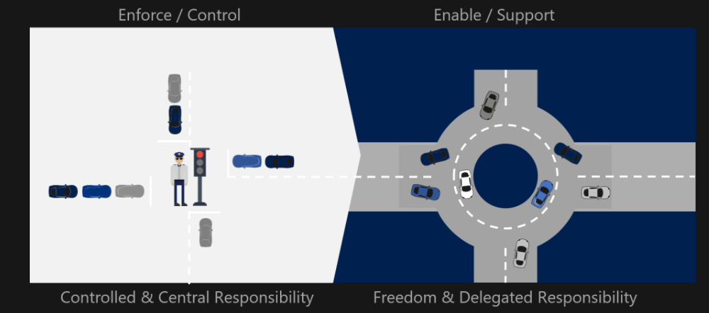

Slide 20
Drivers
Agilità
Costi operativi
Produttività
Resilienza
Notes:
The number one reason customers choose to move to the cloud is for the agility they gain.. You are able to move from idea to implementation in minutes rather than the months it can take to provision services on premises.
In addition to agility, other common reasons customers migrate to the cloud include increased productivity, data center consolidation or rationalization, and preparing for an acquisition, divestiture, or reduction in infrastructure sprawl. Some companies want to completely re-imagine their business as part of a larger digital transformation program. And, of course, organizations are always looking for ways to reduce costs.
Common drivers that apply when migrating to the cloud are:
Operational Costs – Operational costs are the costs of running your infrastructure. They include the unit price of infrastructure, matching supply and demand, investment risk for new applications, markets, and ventures, employing an elastic cost base, and building transparency into the IT operating model.
Workforce Productivity – Workforce productivity is how efficiently you are able to get your services to market. You can quickly provision AWS services, which increases your productivity by letting you focus on the things that make your business different, rather than spending time on the things that don’t, like managing data centers. With over 90 services at your disposal, you eliminate the need to build and maintain these independently. We see workforce productivity improvements of 30%-50% following a large migration.
Cost Avoidance – Cost avoidance is setting up an environment that does not create unnecessary costs. Eliminating the need for hardware refresh and maintenance programs is a key contributor to cost avoidance. Customers tell us they are not interested in the cost and effort required to execute a big refresh cycle or data center renewal and are accelerating their move to the cloud as a result.
Operational Resilience – Operational resilience is reducing your organization’s risk profile and the cost of risk mitigation. With 16 Regions comprising 42 Availability Zones (AZs) as of June 2017, With AWS, you can deploy your applications in multiple regions around the world, which improves your uptime and reduces your risk-related costs. After migrating to AWS, our customers have seen improvements in application performance, better security, and reduction in high-severity incidents. For example, GE Oil & Gas saw a 98% reduction in P1/P0 incidents with improved application performance.
Business Agility – Business agility is the ability to react quickly to changing market conditions. Migrating to the AWS Cloud helps increase your overall operational agility. You can expand into new markets, take products to market quickly, and acquire assets that offer a competitive advantage. You also have the flexibility to speed up divestiture or acquisition of lines of business. Operational speed, standardization, and flexibility develop when you use DevOps models, automation, monitoring, and auto-recovery or high-availability capabilities.

Slide 21
Cloud computing: strategie di migrazione
Migration readiness
Analisi del portfolio (applicazioni)
Le “6 R” (AWS)
Re-host
Re-platform
Re-factor/Re-architect,
Re-purchase
Retire
Retain
Notes:
Items to consider:
Have you clearly defined the scope and the business case for the migration?
Have you evaluated the environment and applications in scope through the lenses of the AWS CAF?
Is your virtual private cloud (VPC) secure, and can it act as a landing zone for all applications in scope?
Have your operations and employee skills been reviewed and updated to accommodate the change?
Do you (or does a partner) have the experience necessary to move the tech-stacks that are in scope?
This is where you start to develop a migration strategy. Consider where your cloud journey fits into your organization’s larger business strategy and find opportunities for alignment of vision. A well-aligned migration strategy, with a supporting business case and a well-thought out migration plan, sets the proper groundwork for cloud adoption success.
One critical aspect of developing your migration strategy is to collect application portfolio data and rationalize it into what we refer to as the 6 R’s: Re-host, Re-platform, Re-factor/Re-architect, Re-purchase, Retire, and Retain. This is a method for categorizing what is in your environment, what the interdependencies are, technical complexity to migrate, and how you’ll go about migrating each application or set of applications. Using the “6 R” Framework, outlined below, group your applications into Re-host, Re-platform, Re-factor/Re-architect, Re-purchase, Retire and Retain. Using this knowledge, you will outline a migration plan for each of the applications in your portfolio. This plan will be iterated on and mature as you progress through the migration, build confidence, learn new capabilities, and better understand your existing estate.
The complexity of migrating existing applications varies, depending on considerations such as architecture, existing licensing agreements, and business requirements. For example, migrating a virtualized, service-oriented architecture is at the low-complexity end of the spectrum. A monolithic mainframe is at the high-complexity end of the spectrum. Typically, you want to begin with an application on the low-complexity end of the spectrum to allow for a quick win to build team confidence and to provide a learning experience. This will help build momentum.
It is important to choose an application that has some business impact. You want to build momentum with each migration; which is difficult to accomplish if you select an application business owners fail to see value in.

Slide 22
Prepararsi
Definire chiaramente il business case della migrazione
Prospettive diverse
Aggiornare operazioni e skill
C’è l’esperienza necessaria?
Notes:
This is where you start to develop a migration strategy. Consider where your cloud journey fits into your organization’s larger business strategy and find opportunities for alignment of vision. A well-aligned migration strategy, with a supporting business case and a well-thought out migration plan, sets the proper groundwork for cloud adoption success.
One critical aspect of developing your migration strategy is to collect application portfolio data and rationalize it into what we refer to as the 6 R’s: Re-host, Re-platform, Re-factor/Re-architect, Re-purchase, Retire, and Retain. This is a method for categorizing what is in your environment, what the interdependencies are, technical complexity to migrate, and how you’ll go about migrating each application or set of applications. Using the “6 R” Framework, outlined below, group your applications into Re-host, Re-platform, Re-factor/Re-architect, Re-purchase, Retire and Retain. Using this knowledge, you will outline a migration plan for each of the applications in your portfolio. This plan will be iterated on and mature as you progress through the migration, build confidence, learn new capabilities, and better understand your existing estate.
The complexity of migrating existing applications varies, depending on considerations such as architecture, existing licensing agreements, and business requirements. For example, migrating a virtualized, service-oriented architecture is at the low-complexity end of the spectrum. A monolithic mainframe is at the high-complexity end of the spectrum. Typically, you want to begin with an application on the low-complexity end of the spectrum to allow for a quick win to build team confidence and to provide a learning experience. This will help build momentum.
It is important to choose an application that has some business impact. You want to build momentum with each migration; which is difficult to accomplish if you select an application business owners fail to see value in.

Slide 23
Cloud computing: strategie di migrazione
Migration readiness
Analisi del portfolio (applicazioni)
Le “6 R” (AWS)
Re-host
Re-platform
Re-factor/Re-architect,
Re-purchase
Retire
Retain
Notes:
This is where you start to develop a migration strategy. Consider where your cloud journey fits into your organization’s larger business strategy and find opportunities for alignment of vision. A well-aligned migration strategy, with a supporting business case and a well-thought out migration plan, sets the proper groundwork for cloud adoption success.
One critical aspect of developing your migration strategy is to collect application portfolio data and rationalize it into what we refer to as the 6 R’s: Re-host, Re-platform, Re-factor/Re-architect, Re-purchase, Retire, and Retain. This is a method for categorizing what is in your environment, what the interdependencies are, technical complexity to migrate, and how you’ll go about migrating each application or set of applications. Using the “6 R” Framework, outlined below, group your applications into Re-host, Re-platform, Re-factor/Re-architect, Re-purchase, Retire and Retain. Using this knowledge, you will outline a migration plan for each of the applications in your portfolio. This plan will be iterated on and mature as you progress through the migration, build confidence, learn new capabilities, and better understand your existing estate.
The complexity of migrating existing applications varies, depending on considerations such as architecture, existing licensing agreements, and business requirements. For example, migrating a virtualized, service-oriented architecture is at the low-complexity end of the spectrum. A monolithic mainframe is at the high-complexity end of the spectrum. Typically, you want to begin with an application on the low-complexity end of the spectrum to allow for a quick win to build team confidence and to provide a learning experience. This will help build momentum.
It is important to choose an application that has some business impact. You want to build momentum with each migration; which is difficult to accomplish if you select an application business owners fail to see value in.

Slide 24








Scenario
Corporate
data center
Log servers
SMTP server
File server
IT
operations
Web servers
database
End
users
LOB applications
Client apps
Internet
Business
operations
Firewall
Build servers
FTP servers
ERP servers
CRM servers
Developers
Dealer app
Dealers
Notes:
https://docs.aws.amazon.com/it_it/whitepapers/latest/aws-migration-whitepaper/building-a-business-case-for-migration.html

Slide 25
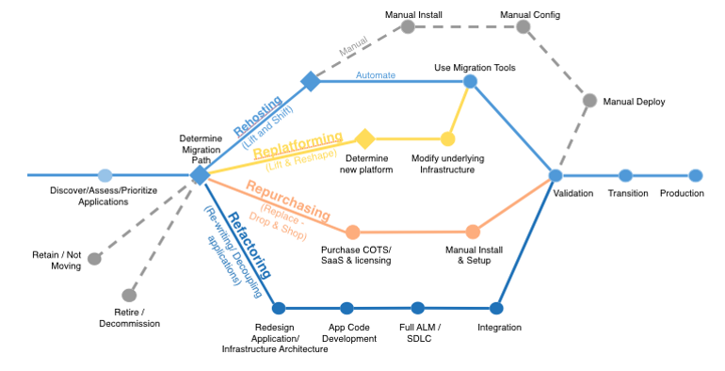

Slide 26
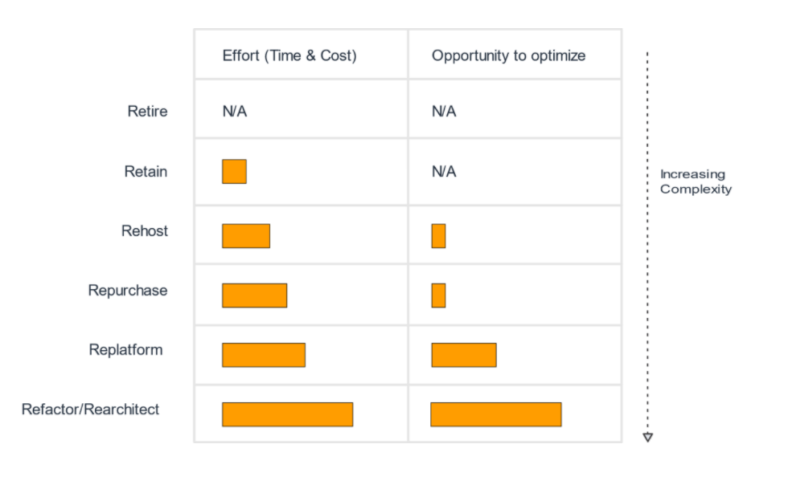
Costo vs benefit

Slide 27
Creare un business case
Quanto costerà l’esercizio della nuova soluzione?
Quanto costerà adottare la nuova soluzione?
Quali benefici otterrò oltre la riduzione dei costi?
Notes:
What is the future expected IT cost on AWS versus the existing (base) cost?
What are the estimated migration investment costs?
What is the expected ROI, and when will the project be cash flow positive?
What are the business benefits beyond cost savings?
Labor Productivity
Estimate of reduction in number of hours spent conducting legacy operational activities (requisitioning, racking, patching)
Productivity gains from automation
Developer productivity
Business Value
Agility (faster time to deploy, flexibility to scale up/scale down, mergers and acquisitions, global expansion)
Cost avoidance (e.g., server refresh, maintenance contracts)
Risk mitigation (e.g., resilience for disaster recovery or performance)
Decommissioned asset reductions

Slide 28
Scenario
Corporate
data center
Log servers
SMTP server
File server
IT
operations
Web servers
database
End
users
LOB applications
Client apps
Internet
Business
operations
Firewall
Build servers
FTP servers
ERP servers
CRM servers
Developers
Dealer app
Dealers
Notes:
https://docs.aws.amazon.com/it_it/whitepapers/latest/aws-migration-whitepaper/building-a-business-case-for-migration.html

Slide 29
Scenario
Corporate
data center
Produttività
Maggior proattività
Log servers
SMTP server
File server
IT
operations
Web servers
database
End
users
LOB applications
Client apps
Internet
Business
operations
Nuovo prodotto in due anni
Firewall
Build servers
FTP servers
ERP servers
CRM servers
Licenze in scadenza
Hardware obsoleto
Aumentare la capacità
Developers
Ambienti di test
Automazione
Dealer app
Dealers
Notes:
https://docs.aws.amazon.com/it_it/whitepapers/latest/aws-migration-whitepaper/building-a-business-case-for-migration.html

Slide 30
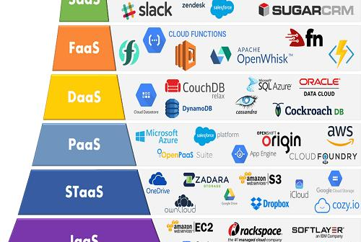
Il mercato

Slide 31
Il mercato
Punti di attenzione
Costi vs SLA
Costi integrazione
Fit con la strategia
Vendor lock-in

Slide 32
Servizi
Analytics
Identity
Media services
Cognitive services
Paas Services (Twilio, Stripe)
Devops
Cost management
System management
Elaborazione (Compute)
Networking
Storage
Integrazione
Database relazionali
Database No-SQL

Slide 33
Compute
In che modo eseguo il mio software?
VM
Containers/Orchestratori
Applicazioni PaaS
Serverless (functions)
Scalabilità
Orizzontale
Verticale
Notes:
containers

Slide 34
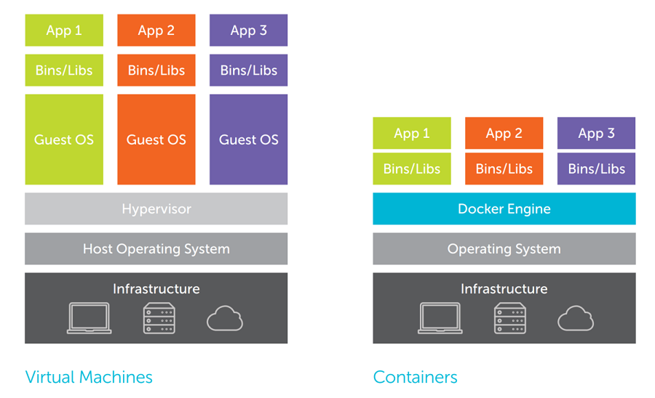
Cloud computing: Il mercato / Compute

Slide 35
Orchestratori container
Provisioning e distribuzione
Ridondanza e disponibilità
Scalare o rimuovere
Spostamento da un host a un altro
Allocazione delle risorse
Esposizione dei servizi
Bilanciamento del carico
Monitoraggio dell'integrità di contenitori e host
Configurazione (YAML)

Slide 36
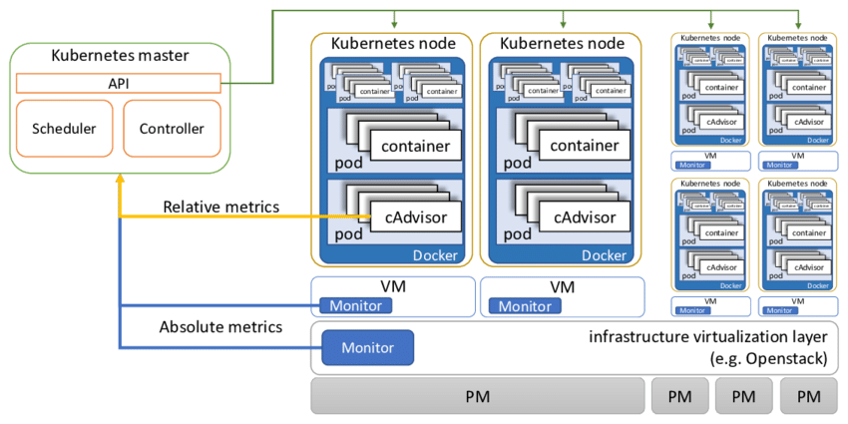
Cloud computing: Il mercato / Compute

Slide 37

Cloud computing: Il mercato / Serverless
*
Senza Server
* Si applicano termini e condizioni

Slide 38
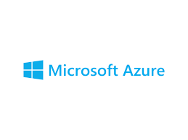
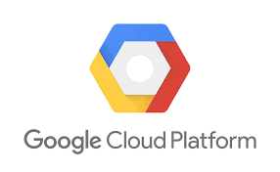

Cloud computing: Il mercato / Compute
AWS EC2 | Azure VM | Google compute engine
AWS ECR/AWS ECS | Azure Registry/Azure Container Instances | Google Container Registry
AWS EKS | Azure AKS | Google Kubernetes Engine
AWS Elastic Beanstalk | Azure Web Apps | Google App Engine
AWS Lambda | Azure functions | Google Cloud Functions

Slide 39
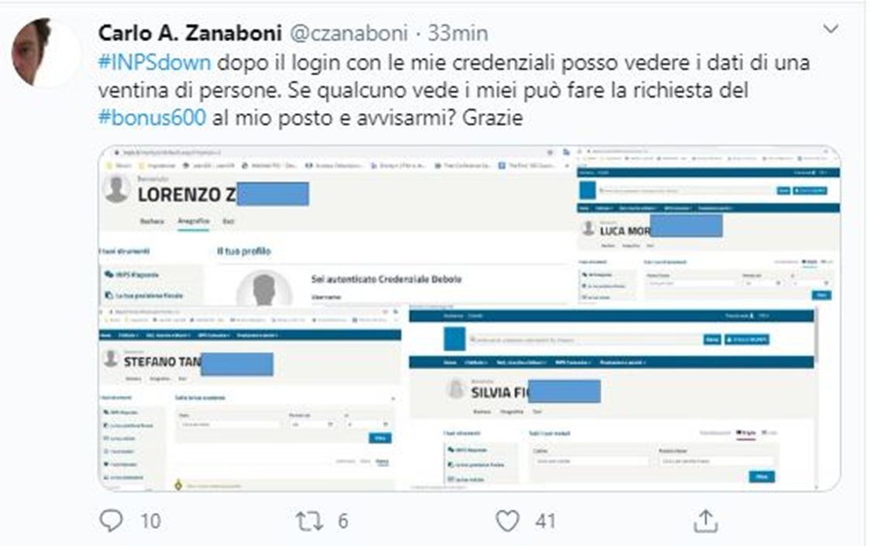


Slide 40
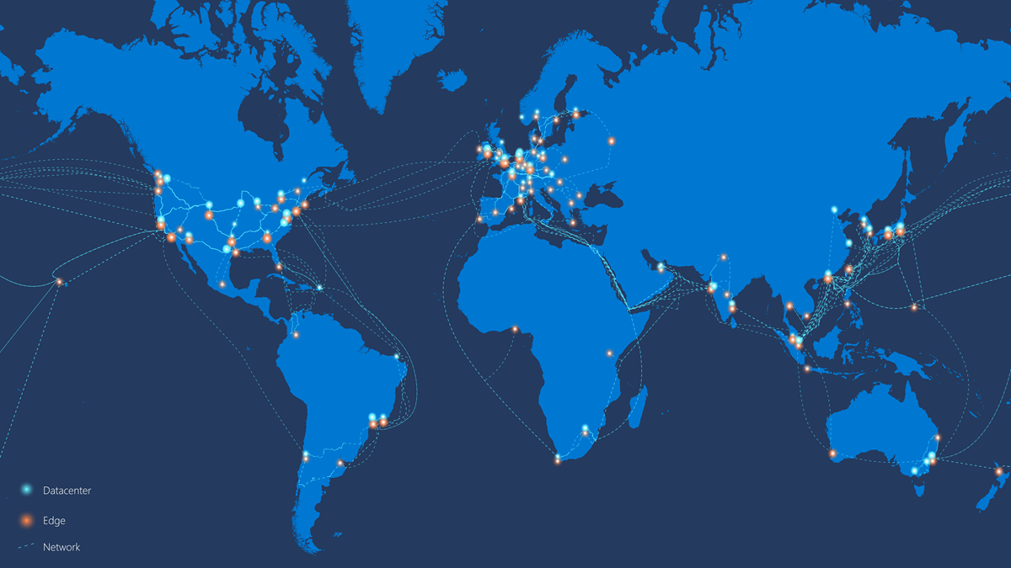

Slide 41
Cloud computing: Il mercato / Networking
Connectivity (virtual networks, VPN, DNS, express routing)
Protection (application firewall, DDoS protections)
Delivery (CDNs, traffic managers)
Monitor

Slide 42
Cloud computing: Il mercato / Networking
Notes:
MS: https://docs.microsoft.com/en-us/azure/networking/networking-overview
AWS: https://aws.amazon.com/products/networking/
GCP: https://cloud.google.com/products/networking#tab1

Slide 43
Cloud computing: Il mercato / Storage
Dischi VM
BLOB Storage
Ridondato globalmente
Diversi SLA (hot/cold)
Cloud file share
Data transfer

Slide 44
Cloud computing: Il mercato / Storage
Notes:
MS: https://docs.microsoft.com/en-us/azure/storage/
AWS: https://aws.amazon.com/products/storage/
GCP: https://cloud.google.com/products/storage

Slide 45
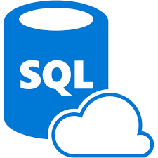
Cloud computing: Il mercato / SQL
Database relazionali
MSSQL,
MySQL,
Oracle
Postgres
Pricing / SLA
Prestazioni
Volumi
Disponibilità
Notes:
MS: https://azure.microsoft.com/en-us/product-categories/databases/
GCP: https://cloud.google.com/sql
AWS: https://aws.amazon.com/products/databases/?nc2=h_ql_prod_db

Slide 46
Cloud computing: Il mercato / No-SQL
Database NO-SQL
Dati non strutturati (generalmente JSON)
Molto scalabili
Globali
Cache distribuite
Table storages
Pricing / SLA
Prestazioni
Volumi
Disponibilità
Notes:
MS: https://azure.microsoft.com/en-us/product-categories/databases/
GCP: https://cloud.google.com/sql
AWS: https://aws.amazon.com/products/databases/?nc2=h_ql_prod_db

Slide 47
Cloud computing: Il mercato / Analytics
Storage e query per grandi quantità di dati (TB,PB)
Analisi in tempo reale di stream di dati
Trasformazione di dati
Machine learning e servizi predittivi
Notes:
MS: https://azure.microsoft.com/en-us/product-categories/analytics/
GCP: https://cloud.google.com/bigquery
AWS: https://aws.amazon.com/big-data/datalakes-and-analytics/?nc2=h_ql_prod_an

Slide 48
Cloud computing: Il mercato / PaaS API
Al confine tra PaaS e SaaS
Twilio
SendGrid
Stripe

Slide 49
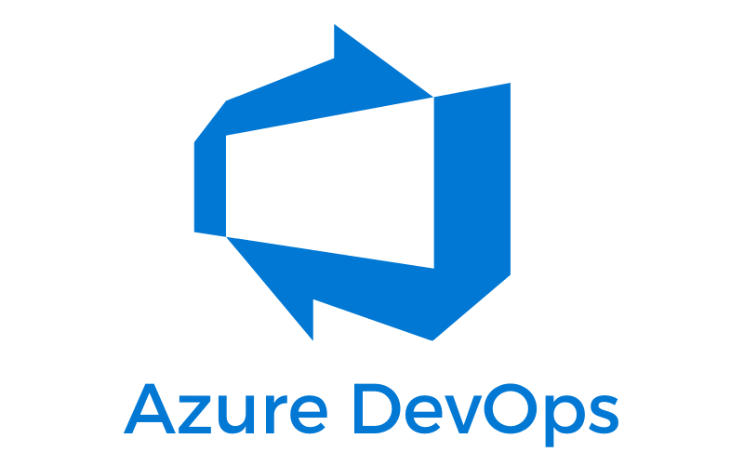
Cloud computing: Il mercato / Devops
Supporto alle operazioni di piattaforma e di Sistema
Supporto alla governance

Slide 50
Migrazione su cloud
Creare un business case
Persone e team
Preparazione e pianificazione
Eseguire la migrazione
Notes:
GCP: https://cloud.google.com/products/calculator
Amazon price calculator: https://calculator.aws/#/addService
Azure price calculator: https://azure.microsoft.com/en-us/pricing/calculator/

Slide 51
Creazione di un business case
A cosa risponde un business case?
Qual è il costo IT previsto per il futuro su cloud rispetto al costo (base) esistente?
Quali sono i costi stimati di investimento per la migrazione?
Qual è il ROI previsto ?
Quali sono i vantaggi per l'azienda oltre al risparmio sui costi?
In che modo l'utilizzo del cloud migliorerà la tua capacità di rispondere ai cambiamenti aziendali?
Notes:
GCP: https://cloud.google.com/products/calculator
Amazon price calculator: https://calculator.aws/#/addService
Azure price calculator: https://azure.microsoft.com/en-us/pricing/calculator/

Slide 52
Creazione di un business case
Le quattro aree da considerare
Costi di esercizio
Costi di modifica
Produttività
Business value
Notes:
Run Cost AnalysisTotal Cost of Ownership (TCO) comparison of run costs on AWS post-migration vs. current operating model
Impact of AWS purchasing/pricing options (Reserved Instances, volume discounts)
Impacts of AWS discounts (Enterprise Discount Program, service credits, e.g., Migration Acceleration Program incentives)
Cost of ChangeMigration planning/consulting costs
Compelling events (e.g., planned refresh, data center lease renewal, divestiture)
Change management (e.g., training establishment of a Cloud Center of Excellence, governance, and operations model)
Application migration cost estimate, parallel environments cost
Labor ProductivityEstimate of reduction in number of hours spent conducting legacy operational activities (requisitioning, racking, patching)
Productivity gains from automation
Developer productivity
Business ValueAgility (faster time to deploy, flexibility to scale up/scale down, mergers and acquisitions, global expansion)
Cost avoidance (e.g., server refresh, maintenance contracts)
Risk mitigation (e.g., resilience for disaster recovery or performance)
Decommissioned asset reductions

Slide 53
Creazione di un business case
Costi di esercizio
Confronto del costo totale di proprietà (TCO) dei costi di esecuzione su cloud post-migrazione (to-be) rispetto al modello operativo corrente (as-is)
Impatto delle opzioni di acquisto / prezzi cloud(istanze riservate, sconti per volume)
Impatti degli sconti cloud (programma di sconti aziendali, crediti di servizio, ad esempio incentivi del programma di accelerazione della migrazione)
Strumenti di analisi dei costi
Azure
AWS

Slide 54
Creazione di un business case
Costi di modifica
Costi di pianificazione / consulenza della migrazione
Eventi interessanti (ad es. Aggiornamento pianificato, rinnovo del leasing del data center, cessione)
Gestione del cambiamento (ad es. Istituzione di formazione di un Cloud Center of Excellence, governance e modello operativo)
Stima dei costi di migrazione dell'applicazione, costo degli ambienti paralleli

Slide 55
Creazione di un business case
Produttività
Stima della riduzione del numero di ore trascorse a condurre attività operative legacy
Aumento di produttività dall'automazione
Produttività degli sviluppatori

Slide 56
Creazione di un business case
Business Value
Agilità (tempi di implementazione più rapidi, flessibilità per aumentare / diminuire, fusioni e acquisizioni, espansione globale)
Riduzione dei costi (ad es. Aggiornamento del server, contratti di manutenzione)
Mitigazione del rischio (ad esempio, resilienza per il ripristino di emergenza o le prestazioni)
Riduzioni di asset dismessi

Slide 57
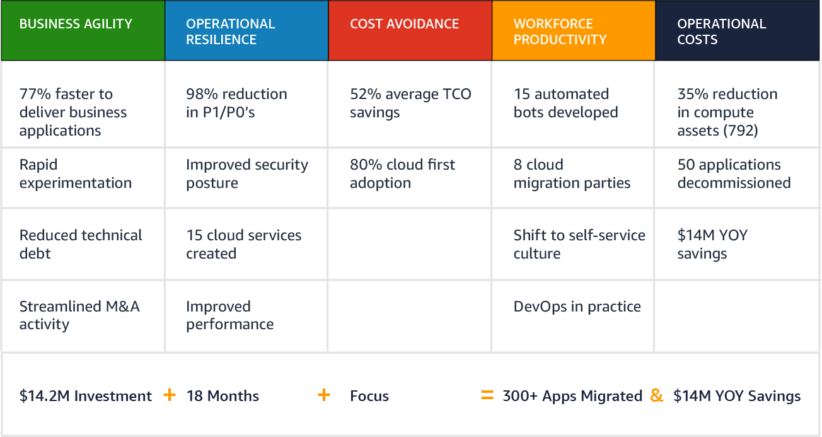
Creazione di un business case

Slide 58
Persone e team
Raggiungere una massa critica di persone con esperienza
Stabilire un processo operativo
Formare un CCoE

Slide 59
Preparazione e pianificazione
Valutazione della disponibilità alla migrazione
Scoperta delle applicazioni
Analisi del portafoglio di applicazioni
Pianificazione della migrazione
Progettazione tecnica

Slide 60
Migration readiness
L'ambito e il business case della migrazione sono chiari?
Le tue operazioni e le competenze dei dipendenti sono state riviste e aggiornate per accogliere il cambiamento?
Tu (o un partner) hai l'esperienza necessaria per spostare gli stack tecnologici che rientrano nell'ambito?
Cloud Journey Tracker

Slide 61
Application Discovery
Processo di scoperta di server e applicazioni on-premise
Fornisce i dati per la pianificazione e la stima dei costi
Performance, utilizzo
Manuale o automatico

Slide 62
Analisi del portafoglio di applicazioni
Input dal passaggio precedente
Si definiscono categorie di alto livello
Identifica l’ordine e le strategie di migrazione
Assegnazione di punteggio e priorità in base a diversi fattori:
risparmio sui costi
criticità aziendale
utilizzo dei server
complessità della migrazione

Slide 63
Analisi del portafoglio di applicazioni
Esempi di categorie:
La maggior parte dei server è basata su Windows con una versione del sistema operativo standard coerente. Alcuni server potrebbero richiedere un aggiornamento del sistema operativo.
Distribuzione dei database su più piattaforme di database: l'80% dei database sono Oracle e il 20% sono SQL Server.
Raggruppamento di applicazioni e server per unità aziendale: 30% di applicazioni di marketing e vendita, 20% di applicazioni per le risorse umane, 40% di applicazioni di produttività interna e 10% di applicazioni di gestione dell'infrastruttura.
Raggruppamento di risorse per tipo di ambiente: 50% di produzione, 30% di test e 20% di sviluppo.

Slide 64
Pianificazione della migrazione
Definire metodi e strumenti di gestione del progetto
Definizione di un project plan
Indentificare ruoli e responsabilità (es: RACI)
Acquisire e distribuire gli strumenti di gestione
Descrivere risorse, tempistiche e costi
Progettazione tecnica
Creazione di un backlog
Poll
Notes:
L'obiettivo principale del piano di migrazione è guidare lo sforzo migratorio complessivo. Ciò include la gestione dell'ambito, della pianificazione, del piano delle risorse, dei problemi e dei rischi, del coordinamento e della comunicazione a tutte le parti interessate. Lavorare in anticipo sul piano può organizzare il progetto poiché più team migrano più applicazioni. Il piano di migrazione considera fattori critici come l'ordine di migrazione per i carichi di lavoro, quando le risorse sono necessarie e il monitoraggio dell'avanzamento della migrazione. Consigliamo al tuo team di utilizzare metodologie di consegna agili, best practice per il controllo del progetto, un solido piano di comunicazione aziendale e un approccio di consegna ben definito.
Le attività consigliate per il piano di migrazione includono:
Revisione di metodi, strumenti e capacità di gestione del progetto per valutare eventuali lacune.
Definire metodi e strumenti di gestione del progetto da utilizzare durante la migrazione.
Definire e creare la Carta del progetto di migrazione / Piano di comunicazione, comprese le procedure di reporting e di escalation.
Sviluppare un piano di progetto, un registro di rischio / mitigazione e una matrice di ruoli e responsabilità (ad esempio, RACI) per gestire i rischi che si verificano durante il progetto e identificare la proprietà per ciascuna risorsa coinvolta.
Procurarsi e distribuire strumenti di gestione del progetto per supportare la consegna del progetto.
Identificare le risorse e i lead chiave per ciascuno dei flussi di lavoro di migrazione definiti in questa sezione.
Facilitare il coordinamento e le attività delineate nel piano.
Descrivi le risorse, le tempistiche e i costi per migrare l'ambiente mirato ad AWS.

Slide 65
Eseguire la migrazione
Ogni applicazione da migrare segue cicli di sei fasi
Discover
Design
Build
Integrate
Validate
Cutover

Slide 66
Eseguire la migrazione
Ogni applicazione da migrare segue cicli di sei fasi
Discover
Design
Build
Integrate
Validate
Cutover

Slide 67
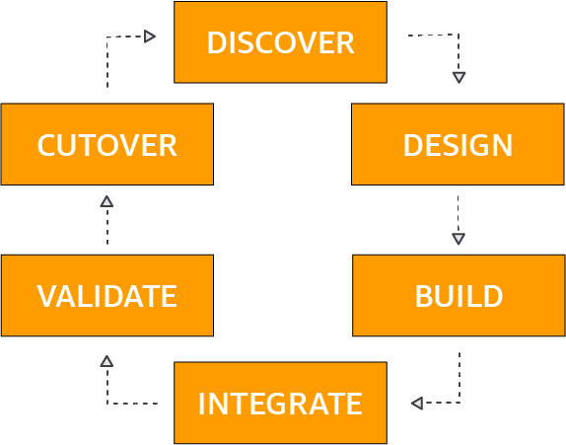
Eseguire la migrazione

Slide 68
Metodologie agili
Rapida comunicazione con tutti gli stakeholders
Il cliente è un componente del team di lavoro
I team sono organizzati per controllare il ciclo di lavoro
Tempi di consegna facilmente rispettati
Rischi attenuati
Cicli più rapidi = maggiore controllo su quanto prodotto
Il lavoro è organizzato in iterazioni

Slide 69
Metodologie agili
I piani hanno vita breve
Sviluppo del software iterativo
Vengono rilasciati degli avanzamenti multipli
Si adattano velocemente ai cambiamenti
Distribuire presto
Distribuire spesso

Slide 70
Che cos’è DevOps?
DevOps è un termine che indica una serie di pratiche atte ad enfatizzare la collaborazione e comunicazione dei team che si occupano di sviluppo (Dev) e di operations (Ops).
Il processo del software delivery e del cambiamento infrastrutturale deve essere automatizzato.
Mira a stabilire una cultura in un ambiente in cui le fasi di build, test e release avvengono ad un passo molto più veloce del normale e con più affidabilità.
Source: https://en.wikipedia.org/wiki/DevOps

Slide 71

Pratiche di DevOps
Infrastructure as Code (IaC)
Continuous Integration
Automated Testing
Continuous Deployment
Release Management
App Performance Monitoring
Load Testing & Auto-Scale
Availability Monitoring
Change/Configuration Management
Automated Environment De-Provisioning
Self Service Environments
Automated Recovery
Feature Toggles
Hypothesis Driven Development

Slide 72
Benefici
Si applica ad ogni app, qualsiasi codice e qualsiasi piattaforma
Funziona in ambito cloud, on-premise o ibrido
Velocizza i rilasci
Produce un prodotto migliore nel tempo
Tempi di recovery quasi azzerati da possibili errori

Slide 73
Getting Started
Usa un sistema di Source Control
Non aspettatevi un cambio immediato
Preparate i test
Tool vecchi e nuovi possono lavorare assieme

Slide 74
Strutturato con elasticità
Cosa servirà al progetto nel giorno 2? Giorno 30? Giorno 100?
Regole di monitoraggio
Alert di monitoraggio
Automation runbooks

Slide 75

Tutti devono adottare DevOps
Se lo adotta solo una parte del team, non ci sono benefici
Notes:
Agile teams within a traditional org structure

Slide 76
Continuous Integration
Necessario il versioning
Consiste nell’allineamento continuo dagli ambienti di lavoro verso l’ambiente condiviso
Complementare al Test Driven Development

Slide 77
Continuos Integration - Principi
Mantieni un repository del codice sorgente
Automatizza il processo build
Ogni commit fa partire una build
La build dovrebbe essere più veloce possibile
Alcuni test sono fatti in un clone dell'ambiente di produzione
Chiunque può vedere i risultati dell'ultima build

Slide 78
Continuos Integration - Principi
La build è un processo può produrre un artefatto.
Deve essere il più possibile automatizzato, senza alcun intervento umano
I test sono fondamentali
Notes:
È inutile «buildare» e testare il sorgente se gli sviluppatori sviluppano codice sui propri computer senza sincronizzarsi spesso col codice scritto da altri.
È importante però che il codice sia compilabile ed abbia superato tutti i test.
Ogni modifica al codice sorgente condiviso potrebbe generare dei bug e quindi compilare e testare subito dà la possibilità di intervenire immediatamente su eventuali bug.
Se un commit di uno sviluppatore è tale da far fallire un test, bisogna intervenire immediatamente prima che si crei una sequenza di errori.

Slide 79
Continuous Integration - Prima
Copia del repository
Processo di build solo nei weekend
Connessione verso i server di test per verifica delle modifiche
Riavvio degli ambienti in ordine
Danze tribali e preghiere varie
Verifica del corretto funzionamento

Slide 80
Continuous Integration - Prima
Copia del repository
Processo di build solo nei weekend
Connessione verso i server di test per verifica delle modifiche
Riavvio degli ambienti in ordine
Danze tribali e preghiere varie
Verifica del corretto funzionamento

Slide 81
Continuous Integration - Dopo
Trigger automatici del servizio di build
Webhook, agent, schedule, manuale
Esecuzione di script automatici
Verifica della qualità
Eventuale lavoro aggiuntivo manuale
Prelevamento dell’output della build

Slide 82
Processo di build
Serie di passaggi da eseguire prima del rilascio
Restore dei pacchetti (dipendenze), build del progetto, tests…
Funziona con pipeline pre-esistenti
Jenkins, Octopus, Ansible,Azure pipelines
Automatizzazione di tutto il possibile
Si può automatizzare tutto tramite PowerShell, bash o similari…

Slide 83
Fase di sviluppo
Write Code
Version Control
Release
Unit Testing
Build

Slide 84
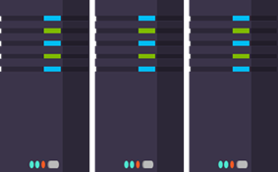
Fase di release
Cloud Load Testing
Integration testing
environment
Staging
environment
Monitor + Learn
Automated functional testing environment
Pre-production environment
Deploy in cloud o on-premises

Slide 85
Continuous deployment
Si rilascia continuamente
Non è importante l’ambiente
Può essere sviluppo, QA come produzione
E se le feature non sono complete?
Feature Flags (o feature toggle)!
Abilitazione tramite flag, anche su PROD

Slide 86
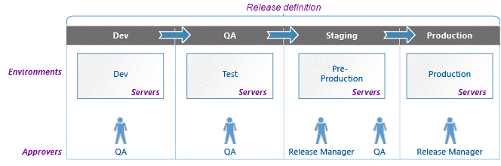
Release definition
Una release definition è una collezione di ambienti diversi
Un ambiente specifica come e dove deve essere effettuato il deployment
Può essere un App Store, un servizio app cloud, un IIS on-premise…
Il deployment è fatto tramite una serie di task

Slide 87
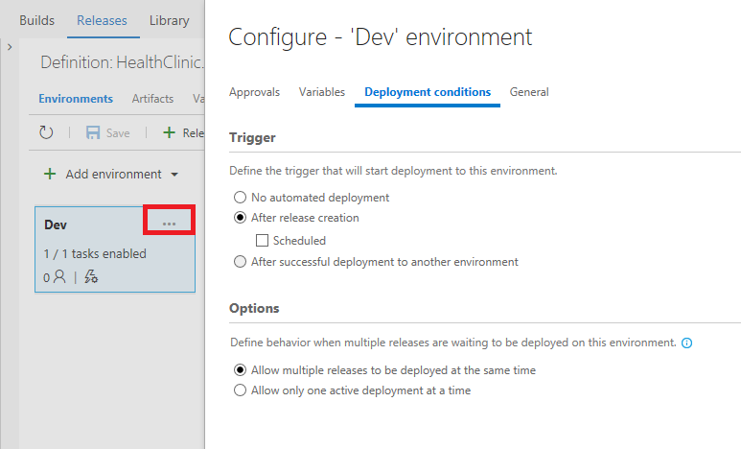
Deployment condizionale
Ogni deployment può essere soggetto a determinate condizioni:
Deploy manuale
Deploy schedulato ad orari specifici
Deploy automatico dopo il deployment dell’ambiente precedente

Slide 88
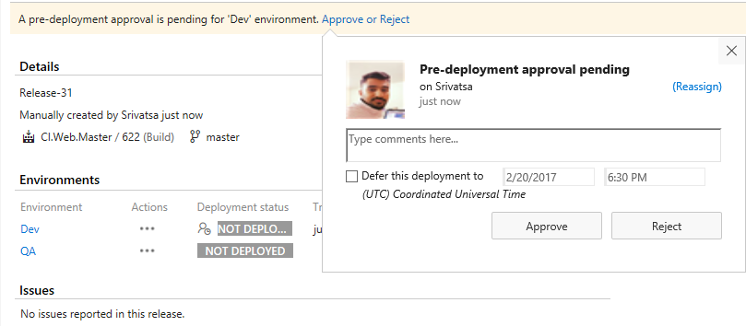
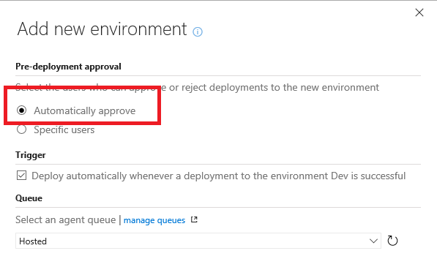
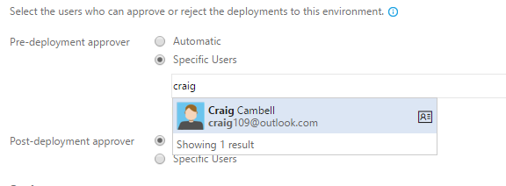
Deployment approval
Ogni deployment deve essere autorizzato:
Automaticamente
Attraverso utenti specifici

Slide 89
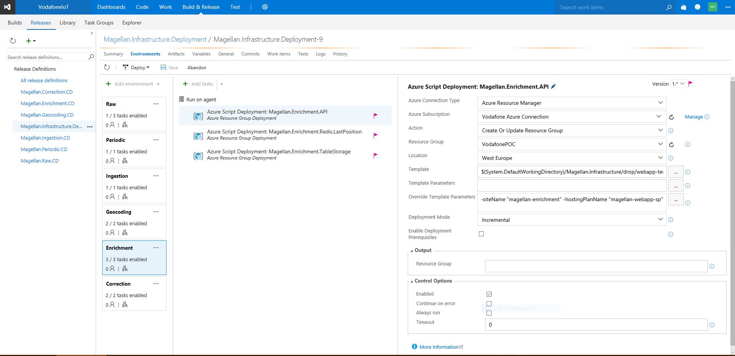
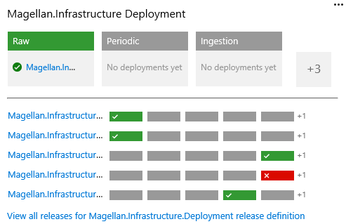
Continuous Deployment

Slide 90
Infrastructure as Code
L’infrastruttura deve essere gestita in modo automatico
Deve fornire risultati predicibili, ogni modifica passa da CI/CD
Anche il codice dell’infrastruttura deve essere sotto source-control e manutenuto
YAML
File strutturato in JSON con definizione dell’infrastruttura
Es: Ansible, Docker

Slide 91





Infrastructure deployment
+
ARM template
Configuration
→
→
Application code
Build & Deploy
Package

Slide 92
Continuous Deployment - Prima
Richiedi/crea una macchina virtuale
Richiedi/gestisci le differenze infrastrutturali
Installa il sistema operativo
Installa l’app o il servizio
Patching, anti-malware, backup, monitoring
Verifica del corretto funzionamento
Go Live

Slide 93
Continuous Deployment - Dopo
La build gira tramite script
Release automatica dopo i test
Deploy degli artifacts verso un ambiente
Lavoro complesso = automazione
Promozione in diversi stage:
QA, Prod, Green/Blue

Slide 94
Monitor and learn
Application Performance Monitoring
Rollout strategy
Start again…
Infrastructure Monitoring
Feedback
Monitoring is key to improvements
Application and Infrastructure monitoring
Feedback from systems and users

Slide 95
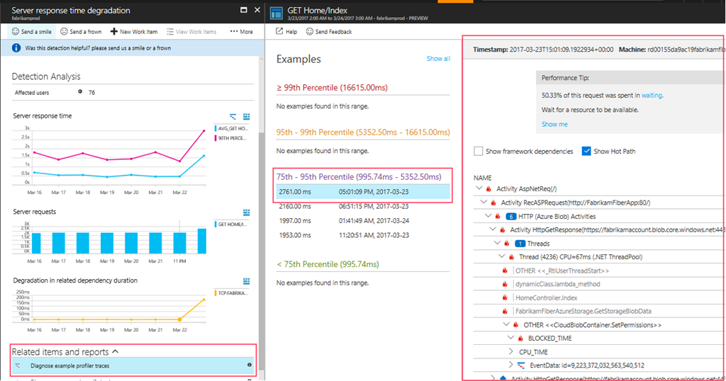
Come si comporta la mia applicazione?

Slide 96
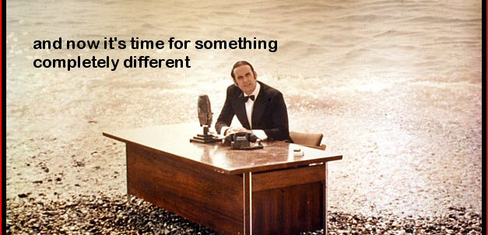

Slide 97
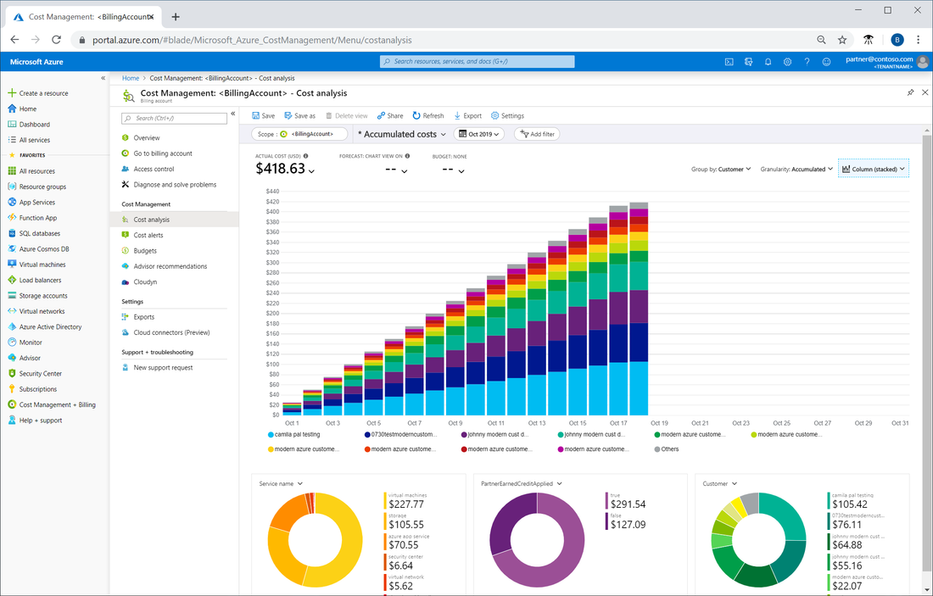

Cloud computing: Il mercato / cost management
Controllo sui consumi cloud
Budget
Spending advisor
Notes:
MS: https://azure.microsoft.com/en-us/services/cost-management/
AWS: https://aws.amazon.com/aws-cost-management/

Slide 98
Processo di ottimizzazione dei costi
Visibility
Accountability
Optimization
Management
Finance
Application teams
Notes:
MS: https://azure.microsoft.com/en-us/services/cost-management/
AWS: https://aws.amazon.com/aws-cost-management/

Slide 99
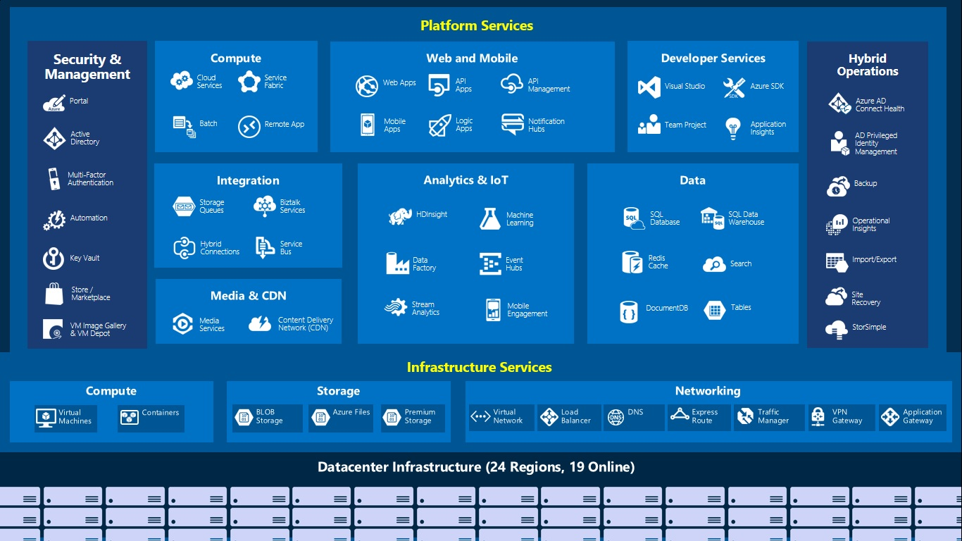
Notes:
MS: https://azure.microsoft.com/en-us/services/cost-management/
AWS: https://aws.amazon.com/aws-cost-management/

Slide 100





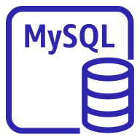






SCOPE
Subscription A
Subscription B
Subscription C
Resource group
Resource group
Resource group
Resource group
Resource group
Resource group
Resource group
Resource group
Notes:
MS: https://azure.microsoft.com/en-us/services/cost-management/
AWS: https://aws.amazon.com/aws-cost-management/

Slide 101
Processo di ottimizzazione dei costi
Visibility
Accountability
Optimization
Visibilità
Analisi dei costi
Esportazione
Notes:
MS: https://azure.microsoft.com/en-us/services/cost-management/
AWS: https://aws.amazon.com/aws-cost-management/

Slide 102
Processo di ottimizzazione dei costi
Visibility
Accountability
Optimization
Visibilità
Analisi dei costi
Esportazione
Accountability
Budget
Notes:
MS: https://azure.microsoft.com/en-us/services/cost-management/
AWS: https://aws.amazon.com/aws-cost-management/

Slide 103
Processo di ottimizzazione dei costi
Visibility
Accountability
Optimization
Visibilità
Analisi dei costi
Esportazione
Accountability
Budget
Ottimizzare
Advisor
Notes:
MS: https://azure.microsoft.com/en-us/services/cost-management/
AWS: https://aws.amazon.com/aws-cost-management/

Slide 104
Cost managers
Visibility
Accountability
Optimization
Espongono API
Supporto multicloud
Notes:
MS: https://azure.microsoft.com/en-us/services/cost-management/
AWS: https://aws.amazon.com/aws-cost-management/

Slide 105
Scenario
Corporate
data center
Produttività
Maggior proattività
Log servers
SMTP server
File server
IT
operations
Web servers
database
End
users
LOB applications
Client apps
Internet
Business
operations
Nuovo prodotto in due anni
Firewall
Build servers
FTP servers
ERP servers
CRM servers
Licenze in scadenza
Hardware obsoleto
Aumentare la capacità
Developers
Ambienti di test
Automazione
Dealer app
Dealers
Notes:
https://docs.aws.amazon.com/it_it/whitepapers/latest/aws-migration-whitepaper/building-a-business-case-for-migration.html

Slide 106

1.a/Re-host
Internet+Firewall
VPN/Private link
SMTP server
Log servers
File server
Web
Oracle
instance
IT
operations
End
users
LOB applications
Client apps
Internet
Business
operations
Firewall
Build servers
FTP servers
ERP servers
CRM servers
Developers
Dealer app
Dealers

Slide 107

1.b/Re-host+Re-platform
Internet+Firewall
VPN/Private link
SMTP server
Log servers
File server
Web
Oracle Managed
instance
IT
operations
End
users
Web
LOB applications
Client apps
Internet
Test env
Business
operations
Web
Oracle
Firewall
Build servers
FTP servers
ERP servers
CRM servers
Developers
Cloud ibrido
Dealer app
Dealers

Slide 108
1/Analisi dei risultati
Implementazione molto rapida
Cost saving su licenze/hardware
Maggiore scalabilità
Produttività aumentata
Notes:
https://docs.aws.amazon.com/it_it/whitepapers/latest/aws-migration-whitepaper/building-a-business-case-for-migration.html

Slide 109

1.c/Re-host+Re-platform-Re-purchase
AWS Systems Manager
Internet+Firewall
VPN/Private link
SMTP server
Log/Monitor servers
File server
IT
operations
Web
Oracle Managed
instance
End
users
Web
LOB applications
Client apps
Internet
Test env
Business
operations
Web
Oracle
Firewall
Build servers
FTP servers
ERP servers
CRM servers
Developers
Dealer app
Dealers

Slide 110

2/Analisi
Internet+Firewall
VPN/Private link
SMTP server
File server
Web
Oracle Managed
instance
IT
operations
End
users
Web
LOB applications
Client apps
Internet
Business
operations
Firewall
FTP servers
ERP servers
CRM servers
Systems Manager
CodePipeline
Developers
Dealer app
Dealers

Slide 111

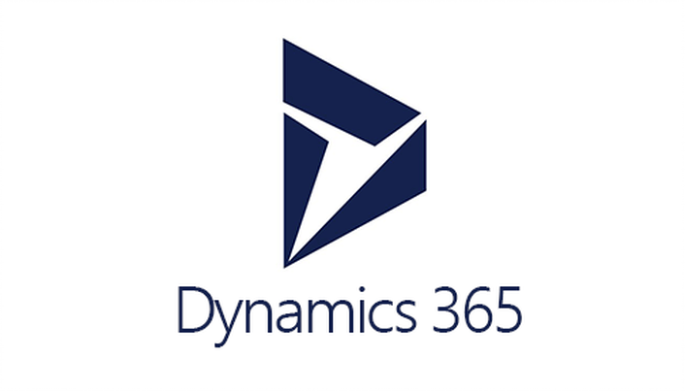

2/Re-purchase Re-factor
LOB applications
Business
operations
Internet+Firewall
VPN/Private link
SMTP server
File server
Web
Oracle Managed
instance
End
users
Web
LOB applications
Client apps
IT
operations
Internet
LOB applications
Firewall
FTP servers
ERP servers
CRM servers
Systems Manager
AWS CodePipeline
Developers
Multicloud
Dealer app
Dealers

Slide 112
Modelli di delivery
Ibrido
Pubblico
Privato
Cloud burst
Community cloud
Notes:
https://docs.aws.amazon.com/it_it/whitepapers/latest/aws-migration-whitepaper/building-a-business-case-for-migration.html

Slide 113
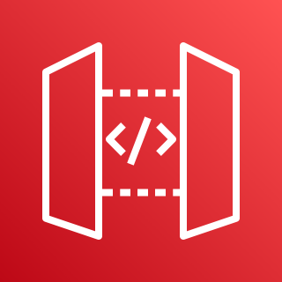

Dealer app
Dealers
LOB applications
API gateway
Business
operations
Internet+Firewall
VPN/Private link
SMTP server
File server
Web
Oracle Managed
instance
LOB applications
Web
Client apps
IT
operations
End
users
Internet
LOB applications
storage
Firewall
FTP servers
ERP servers
AWS CodePipeline
Developers
Systems Manager

Slide 114
Wrap up
Un mondo in continua evoluzione
Adozione
Usare un framework di riferimento
Migrare in modo graduale
Agile + Devops
Percorsi
Developers/Architect
Devops
IT Managers
Notes:
https://docs.aws.amazon.com/it_it/whitepapers/latest/aws-migration-whitepaper/building-a-business-case-for-migration.html

Slide 115


